Slide 1


Introduction to
Robotic Process Automation
ACCIDENT REPORT
GENERATOR
220701244
SANDHIYA K
DR.N.DURAI MURUGAN M.E., ph.D.
Computer Science and Engineering

Slide 2
Abstract
The Accident Report System is an advanced Robotic Process Automation (RPA) solution designed to streamline the process of generating and managing accident reports. Using UiPath, this system automates the collection and processing of essential accident details. Users input key information such as the accident location, involved parties, and incident description via an interactive dialog box. The system then retrieves relevant accident data from external sources, such as police reports, insurance details, and weather conditions, using web scraping techniques. These processes run concurrently with the Parallel activity to maximize efficiency. The extracted information is then compiled into a structured accident report, which is saved in a text or Word format, converted to PDF, and sent to the relevant stakeholders via email using the SMTP Mail Message activity. By automating the entire report generation process, the system reduces manual effort and ensures timely delivery of accurate, comprehensive accident reports. This project highlights the power of RPA in improving efficiency and accuracy in routine administrative tasks.

Slide 3
Need for the Proposed System
Automation: The system automates accident report generation, eliminating manual data collection and report preparation, saving time and effort.
Efficiency: It extracts data from multiple sources concurrently, speeding up the process and ensuring timely report generation.
Accuracy: Automation reduces errors by ensuring precise data extraction and report compilation.
User Convenience: Users receive a structured PDF report via email, providing easy access to all necessary accident details.
Cost-Effectiveness: The system reduces resource requirements, making it a cost-effective solution by minimizing manual intervention.

Slide 4
Advantages of the Proposed System
The system automates accident reporting, saving time and effort with precise and accurate data extraction. Parallel processing ensures faster execution by handling multiple data sources simultaneously. Users receive a professional, organized PDF report delivered directly to their email for convenience. It is cost-effective, scalable, and adaptable to include additional data sources or integrate with other systems. The solution integrates automation seamlessly, enhancing user experience and demonstrating the practical application of RPA in accident management.

Slide 5
Literature Survey
Paper 1
Advantages
Disadvantages
Paper 2
Advantages
Disadvantages

Slide 6
Main Objective
The objective of the Accident Report System is to automate the generation of accident reports using Robotic Process Automation (RPA) tools like UiPath. It streamlines data collection from various sources, ensuring quick, accurate, and consistent reporting with minimal manual effort.
The system compiles accident details into a professional PDF report and delivers it to stakeholders via email. It is scalable, cost-effective, and adaptable for integration with platforms like insurance and legal databases, enhancing efficiency and user experience in industries such as insurance and law enforcement.

Slide 7
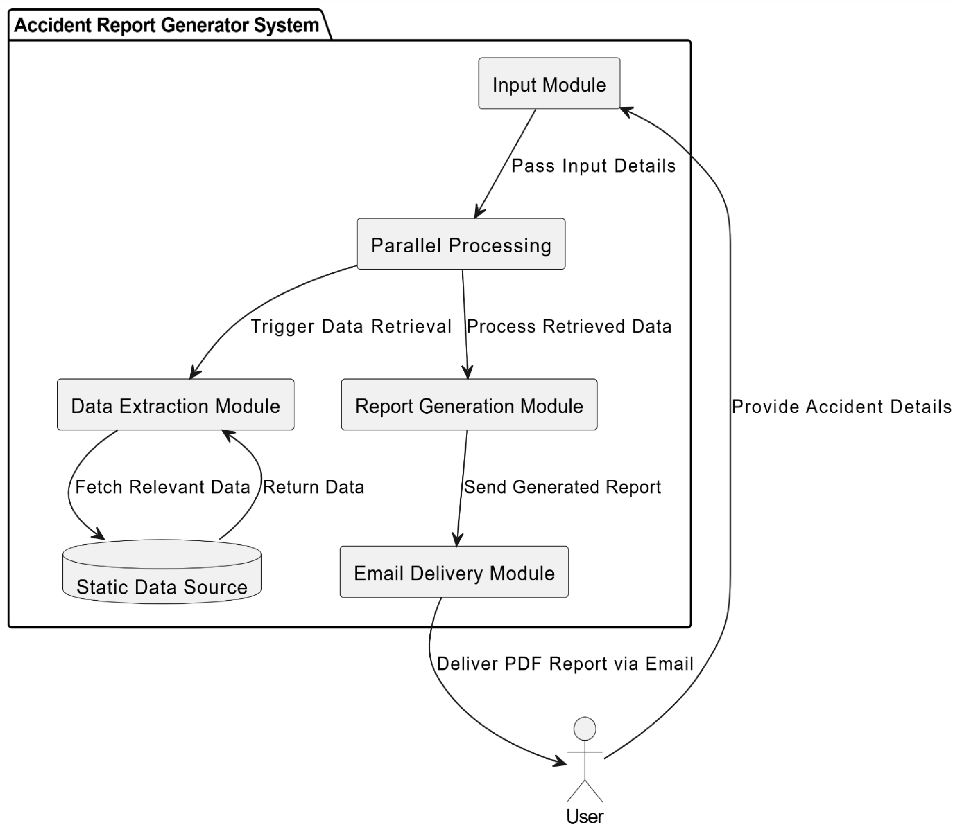
Architecture
.

Slide 8
System Requirements
1. Hardware Requirements
Processor: Minimum Dual-Core, 2.5 GHz (Recommended: Quad-Core for better performance).
RAM: Minimum 4 GB (Recommended: 8 GB or higher for faster execution).
Storage: At least 500 MB of free space for application files and temporary data.
Display: Minimum resolution of 1024x768 pixels.
Network: Stable internet connection for web scraping and email delivery.
2. Software Requirements
Operating System: Windows 10/11, macOS, or Linux (any modern OS supporting RPA tools).
Programming Environment: Python 3.7+ for script development.
Libraries/Packages:
Selenium: For web scraping.
PyPDF2 or FPDF: For generating PDF reports.
smtplib: For email automation.
RPA Tool: UiPath or a similar tool for workflow automation.
Browser: Google Chrome, Firefox, or equivalent for web scraping tasks.
Email Server: SMTP-compatible server (e.g., Gmail SMTP) for email delivery.

Slide 9
Functional Description
Module 1: User Input and Data Collection
Allows users to input accident details (e.g., location, date, and description) via a form, which triggers the automation process.
Module 2: Data Extraction and Processing
Retrieves supplemental data like weather conditions and police records using RPA tools and processes it for report creation.
Module 3: Report Generation
Compiles input and extracted data into a professional PDF report using libraries like PyPDF2 or FPDF.
Module 4: Email Automation and Delivery
Sends the generated PDF report to stakeholders via email using an SMTP-compatible server.

Slide 10
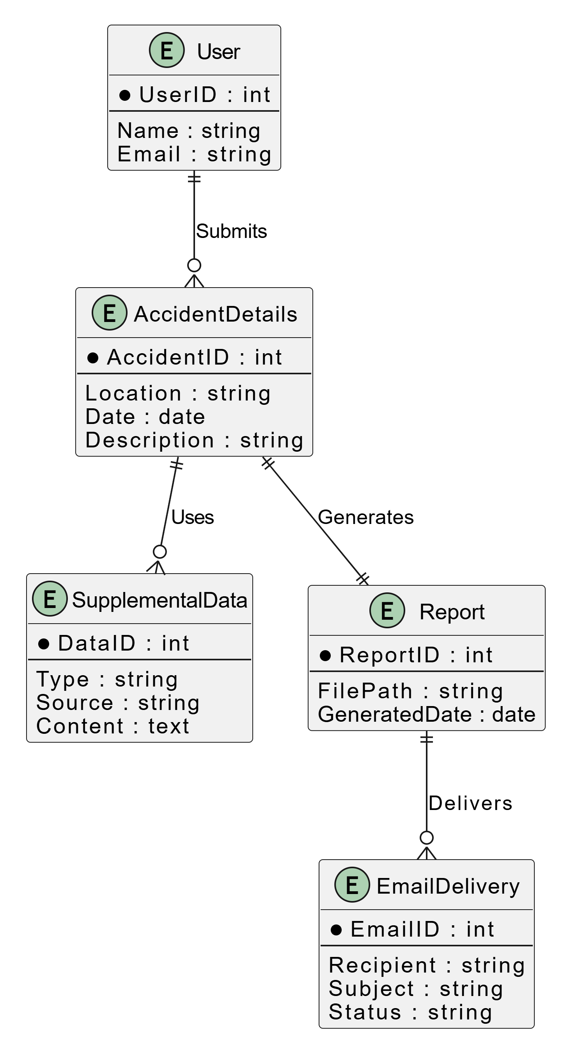
Table Design
.

Slide 11
Process Design
Input Collection: The user inputs accident details such as location, date, involved parties, and a brief description through an input dialog box.
Data Retrieval: The system extracts supplemental information from multiple sources, such as weather conditions, police records, and relevant databases, using web scraping and APIs.
Parallel Processing: All data retrieval tasks are executed simultaneously to ensure quick processing and improved efficiency.
Data Compilation: The collected details are aggregated into a structured format and prepared for report generation.
PDF Generation: The compiled information is formatted into a professional PDF report using automation tools.
Email Delivery: The system delivers the generated PDF report to the user or relevant stakeholders via an SMTP-compatible mail server.

Slide 12
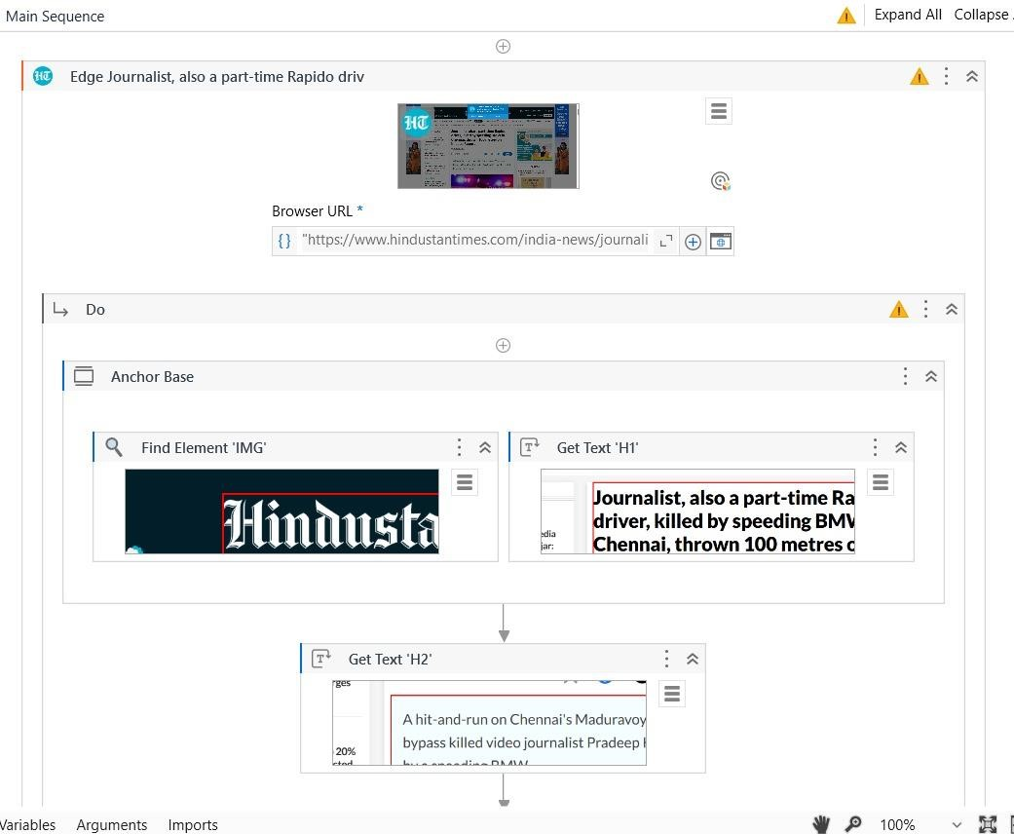
Implementation
user module

Slide 13
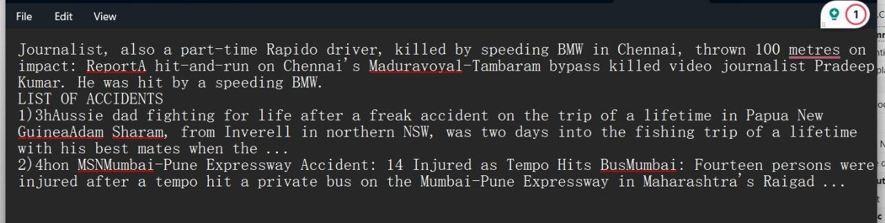
Testing
The Accident Report System undergoes thorough testing to ensure accuracy in data collection, processing, and report generation. This includes functional testing for user inputs, data retrieval, and PDF generation, as well as performance testing for system efficiency. Additionally, real-world scenarios are tested to validate the system's integration with external data sources and email delivery functionality.

Slide 14
Conclusions
The "Accident Report Generator" project successfully automates the process of generating detailed accident reports, streamlining the extraction of critical data such as incident location, causes, and safety recommendations. By utilizing UiPath's RPA capabilities, the system efficiently retrieves information, processes it in parallel, and compiles it into a structured report. This project showcases the power of RPA to improve efficiency and enhance the reporting process, eliminating the need for manual data collection and report creation. With automated email delivery, the solution ensures a seamless and user-friendly experience, making accident reporting faster and more reliable. The "Accident Report Generator" lays the groundwork for future advancements in automation within the safety and accident reporting domain, offering potential for scalability, improved accuracy, and ease of use in future iterations.

Slide 15
Future Enhancement
Real-Time Data Integration: Integrate real-time traffic and weather data for more accurate accident reports.
Multi-Incident Reporting: Support multiple accident reports in one workflow for larger-scale incidents.
Integration with Maps: Add mapping features to visualize accident locations and calculate distances.
Voice Input Support: Allow voice commands for hands-free reporting, especially for first responders.
Mobile Application: Create a mobile app for easy access and report generation on smartphones.
Feedback Mechanism: Include a feedback system to gather user reviews and improve future versions.

Slide 16
References
Avasarala, V. (2019). Robotic Process Automation: The Next Transformation in Digital Transformation. International Journal of Advanced Research in Computer Science, 10(3), 5-12.
Lacity, M. C., & Willcocks, L. P. (2016). A Survey on Robotic Process Automation in Business. Journal of Information Technology, 31(2), 174183.
Goudar, R. H., & Soni, M. P. (2017). Automation and Monitoring in Cloud Computing Systems. Journal of Cloud Computing: Advances, Systems, and Applications, 6(1), 23-36.

Slide 18
Thank You

